Slide 1
Today in science…

Slide 2
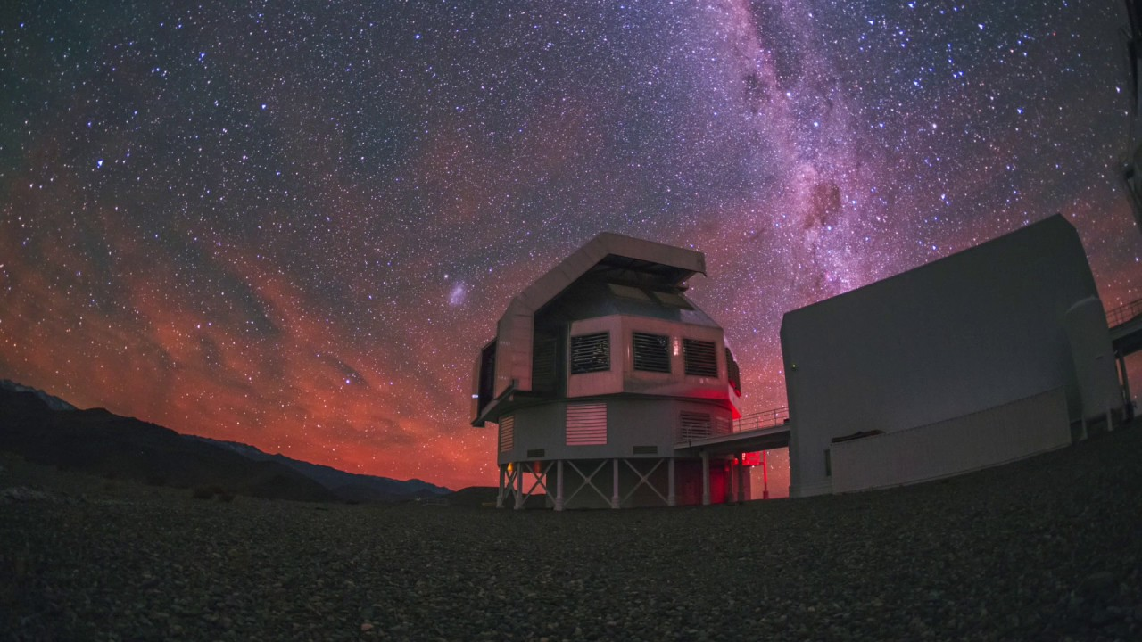
Telescopes
The Cosmic Perspective, Ch. 6

Slide 3
Everyday light sensors
What are some ways we gather light every day?
Our eyes
Our eye…phones
Cameras

Slide 4
Eye and Optics
Refraction causes the light to converge to a focal point
Refraction is the bending of light
How much light is refracted depends on…
The material it passes through and
its shape

Slide 5
Focal Plane
The focal plane is where light from different directions forms a clear image
With a single lens the image is upside-down
Our brains autocorrect the image to be right-side up

Slide 6
Light recorders

Slide 7
Collecting Light with Telescopes
Telescopes are giant eyes, collecting more light than we could with our naked eyes
Telescopes are characterized by 2 key properties
Light-collecting area (depends on the telescope size)
Angular resolution (how much detail we can see in the telescope’s images)

Slide 8
Telescope Design
Two basic designs: Refracting and Reflecting telescopes
Refracting telescope uses transparent glass lenses to focus the light
(from Galileo’s small telescopes to a 1-m refractor)
Refractor problems:
Large lenses are heavy (1-m lens weights 500 lbs)
Different colors focus in different places

Slide 9
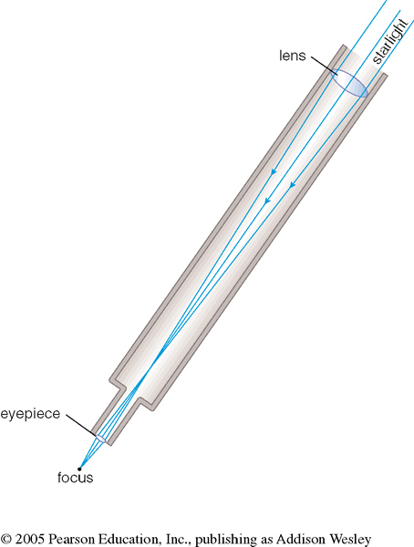
Refractors

Slide 10
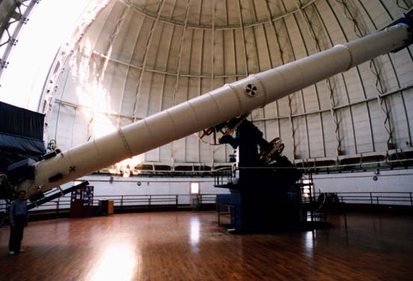
Refractors
40-inch Yerkes Observatory refractor

Slide 11
Telescope Design
Reflecting telescopes use precisely curved mirrors
Most contemporary telescopes are reflectors
Primary mirror gathers and focuses the light
Secondary mirror reflects the light to a convenient location

Slide 12
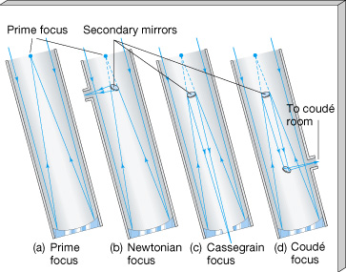
Reflectors

Slide 13
Reflectors
Notes:
Left: 3-college observatory 0.8m primary mirror
Right: Magellan Clay telescope, 6.5m primary mirror http://lascampanasbelles.blogspot.com/2015/11/giant-magellan-telescope-groundbreaking.html

Slide 14
Limit on Angular Resolution
Angular resolution is the minimum angle (θ_{min}) between any two objects to be viewed separately.
Wave nature of light puts a limit to the ability to resolve distant objects
Two objects are considered just resolved if the central maximum of one image positionally coincides with the first minimum of the second image.
θ_{min} = 2.5*10⁵ λ/D (arcseconds)
λ − wavelength of the incoming light
D − diameter of the telescope’s primary mirror

Slide 15
Uses of Telescopes
Imaging: pictures of celestial objects
Notes:
https://apod.nasa.gov/apod/ap050908.html

Slide 16
Uses of Telescopes
Imaging: pictures of celestial objects
Spectroscopy: dispersing light into a spectrum
Notes:
https://apod.nasa.gov/apod/ap050227.html

Slide 17
Uses of Telescopes
Imaging: pictures of celestial objects
Spectroscopy: dispersing light into a spectrum
Timing: tracking time variations of light
Notes:
https://www.aavso.org/variables-what-are-they-why-observe-them
https://www.researchgate.net/figure/Folded-light-curve-of-2MASS-J20060657-1230376_fig7_285413773
(images on the left and light curve on the right are not of the same star)

Slide 18
Uses of Telescopes
Imaging: pictures of celestial objects
Spectroscopy: dispersing light into a spectrum
Timing: tracking time variations of light
Atmosphere affects observations: light pollution, turbulence
Turbulence can be corrected by adaptive optics
Notes:
http://www.ucolick.org/~max/History_AO_Max.htm

Slide 19
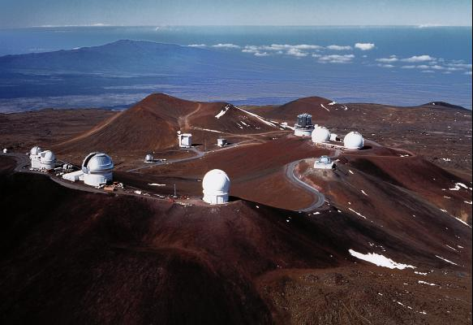
Observatories (Mauna Kea, Hawaii)

Slide 20
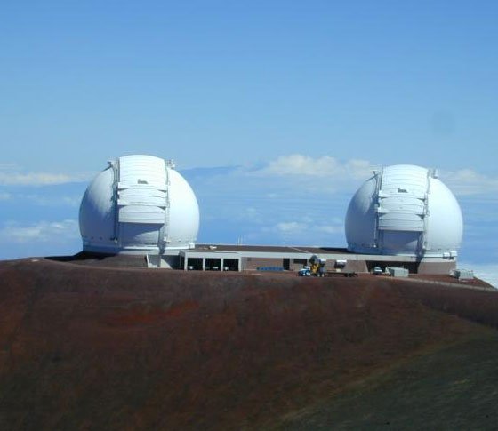
The Keck Telescopes

Slide 21
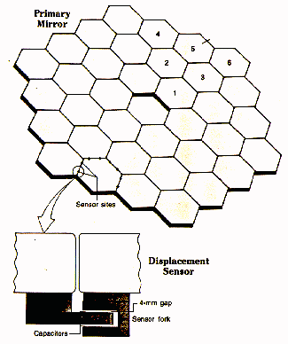
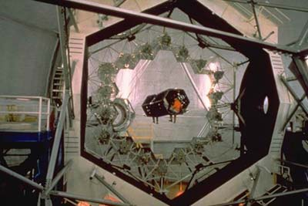
The Keck Mirrors

Slide 22
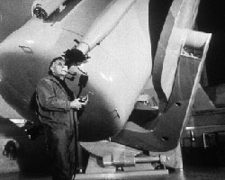
Astronomers at Work (Past)
Notes:
Left: Vera Rubin
Right:

Slide 23
Astronomers at Work (Current)
Notes:
Professor Jedidah Isler (left)
Photos on the right I took on an observing run at a 6.5m telescope (Magellan/Clay). I was running the less complicated setup to the left, just controlling the instrument while an operator pointed the telescope for me.

Slide 24
Infrared Astronomy
Infrared (IR) spectral region lies just outside of the optical (visual) one.
Characteristic wavelengths: 0.8 microns − 1 mm.
Typical temperature for us on Earth is ~300 K (80 F).
At this temperature, objects emit IR waves peaking at ~10 microns.
Therefore, IR detectors need to be cooled down to temperatures of a few K (~ −400 F).
IR telescopes are located at a high elevation to reduce atmospheric absorption of IR radiation.

Slide 25
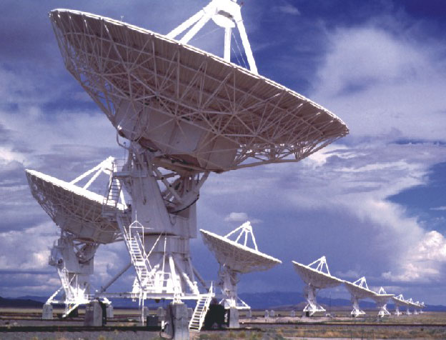
Radio telescopes

Slide 26
Interferometry
Remember how I talked about destructive and constructive interference of light?
Interferometry constructively interferes light from multiple telescopes like one huge telescope would be able to resolve
Angular resolution depends on the separation of the telescopes
Total spatial resolution depends on the number of telescopes and angles between them

Slide 27
Interferometry

Slide 28
Interferometry

Slide 29
Interferometry
What’s the advantage of more telescopes/farther separated?
Notes:
Keck telescopes being used together as interferometer

Slide 30
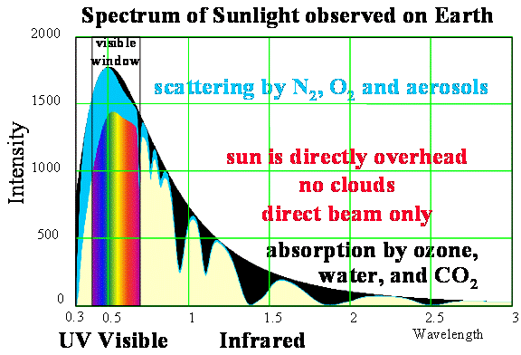
Getting out of the atmosphere
Notes:
Why would we want to leave Earth’s atmosphere to look at the Universe?
https://web.calpoly.edu/~rfield/Thermalstructure.htm

Slide 31
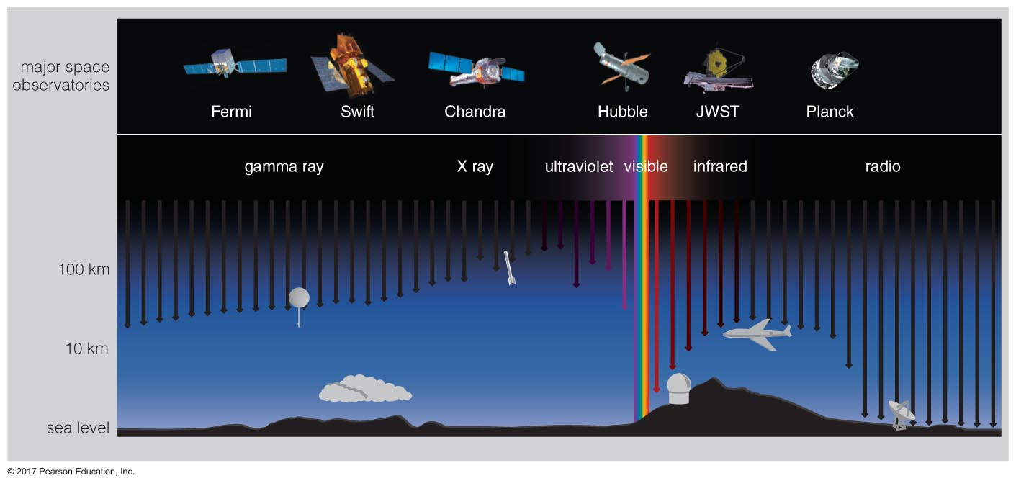
Getting out of the atmosphere

Slide 32
Getting out of the atmosphere
How to get out of the atmosphere?
Balloons – 40 km above sea level, above 99.997% of Earth’s atmosphere
Sounding rockets – sub-orbital; don’t go into orbit or reach escape velocity, but do exit Earth’s atmosphere
Satellites – Earth-orbiting or in some stable orbit between Earth and Sun
In 1949, a sounding rocket discovered the Sun emits X-rays
Notes:
https://heasarc.gsfc.nasa.gov/docs/objects/heapow/archive/solar_system/yohkoh_solar_cycle.html

Slide 33
Satellites
First satellite − 1957 Soviet Sputnik
First astronomical satellites − late 1960’s
Discovery of cosmic X-rays – 1964, sounding rocket; confirmed 1970, Uhuru Satellite
The Hubble Space Telescope (HST) − 1990
The Chandra X-ray Observatory − 1999
The Spitzer Space (IR) Observatory − 2003
Notes:
Cosmic x-ray sources https://en.wikipedia.org/wiki/Cygnus_X-1
Hubble http://hubblesite.org
Chandra https://www.nasa.gov/audience/forstudents/k-4/dictionary/Chandra_X-ray_Observatory.html
Spitzer https://en.wikipedia.org/wiki/Spitzer_Space_Telescope

Slide 34
Hubble observes… Neptune
Notes:
http://imgsrc.hubblesite.org/hu/db/2005/22/images/a/formats/web_print.jpg

Slide 35
Hubble observes… Jupiter
Notes:
http://hubblesite.org/image/1598/news_release/2004-30
https://www.spacetelescope.org/news/heic1613/?lang

Slide 36
Hubble observes… Uranus
Notes:
http://hubblesite.org/image/719/news_release/1998-35
https://www.skyandtelescope.com/astronomy-resources/astronomy-questions-answers/why-dont-we-say-it-has-a-direct-spin-with-the-axis-tilted-82176-instead-of-98176/

Slide 37
Hubble observes… Nebulae
Notes:
http://hubblesite.org/image/1040/news_release/2001-12

Slide 38
Summary
Summary
Spectral information gives us more knowledge about celestial objects (composition, surface temperature, moving properties)
Visible light is only a small portion of the electromagnetic spectrum
Telescopes work as giant eyes, enabling us to see the Universe in great detail
The ultimate place to observe the Universe is space!

